Slide 1
Computer Architecture
Lecture 7

Slide 2
R-format instructions
opcode | rs | rt | rd | shamt | funct
6 bits | 5 bits | 5 bits | 5 bits | 5 bits | 6 bits
32 bits
$s0 → R16
$s1 → R17
$s2 → R18
add $s2, $s0, $s1
Representation in decimal →
0 | 16 | 17 | 18 | 0 | 32
Representation in binary →
000000 | 10000 | 10001 | 10010 | 00000 | 100000

Slide 3
I-format instructions
opcode | rs | rt | immediate
6 bits | 5 bits | 5 bits | 16 bits
32 bits
$s0 → R16
$s1 → R17
addi $s1, $s0, 20
Representation in decimal →
8 | 16 | 17 | 20
Representation in binary →
001000 | 10000 | 10001 | 010100

Slide 4
I-format instructions
opcode | rs | rt | immediate
6 bits | 5 bits | 5 bits | 16 bits
32 bits
N.B.: Branch, some load and store instructions are I-format instructions that have exceptions when translating them to binary → we will discuss that later

Slide 5
Load and store instructions
I-format
opcode | rs | rt | offset
6 bits | 5 bits | 5 bits | 16 bits
32 bits
lw $s0, 5($t1)
35 | 10 | 16 | 5

Slide 6
Load and store instructions
I-format
opcode | rs | rt | offset
6 bits | 5 bits | 5 bits | 16 bits
32 bits
sw $s1, 8($t1)
43 | 10 | 17 | 8

Slide 7

Branch instruction
li $s1, 5
li $s2, 3
beq $s1, $s2, label
add $t0, $t1, $t2
mul $t3, $t1, $t2
div $t3, $t1, $t2
label: sub $t0, $t1, $t2
beq $s1, $s2, label
3 instructions to the place of branch
5 | 16 | 17 | 3
How to get the real address:
(PC+4) + (offset*4)
I-format
opcode | rs | rt | offset
6 bits | 5 bits | 5 bits | 16 bits
32 bits

Slide 8
J-format instructions
opcode | address
6 bits | 26 bits
32 bits
j 1028
1028/4 = 257
We will know why later..
2 | 257

Slide 9
MIPS Data Path

Slide 10
Datapath
A data path is the hardware composed of a collection of functional units (elements) that perform data processing operations, for example, ALU, registers, multiplexers, and internal buses.

Slide 11
Datapath elements
The datapath elements are the functional blocks within a microprocessor that actually interact to perform computational operations.
These tasks include reading/writing to memory, arithmetic, logic operations, and numerical shift operations.

Slide 12
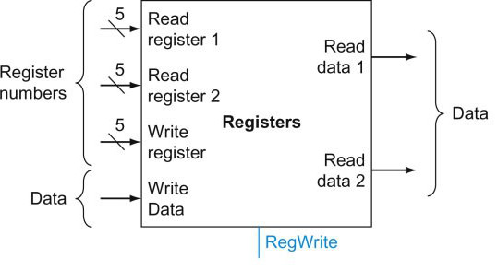

Registers File
opcode | rs | rt | rd | shamt | funct
6 bits | 5 bits | 5 bits | 5 bits | 5 bits | 6 bits
32 bits
add $s2, $s0, $s1
0 | 16 | 17 | 18 | 0 | 32
$s0
$s1
$s2
All inputs and outputs are in binary
50
40
90

Slide 13
Registers File
The register file is a unit that contains the 32 general purpose registers.
Any register can be read or written by specifying the register number.
The register file has two 5-bit inputs that specify the numbers of the registers to be read.
The register file can read and output the two registers at the same time.
The register file also has a 5-bit input that specifies the number of the register to write.
The register file can read and write during the same clock cycle.

Slide 14
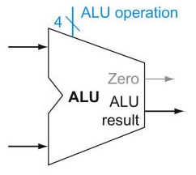
ALU
ALU is an element that performs arithmetic and logical operations.
It has two inputs: the data from the two registers and an output ALU result, which is the result of the operation.
Another output is the ‘Zero’ which will be set to ‘1’ if the ALU result is zero and cleared to ‘0’ if the ALU result is any other value.
ALU is also used to compute a memory address or perform a comparison for a branch.

Slide 15
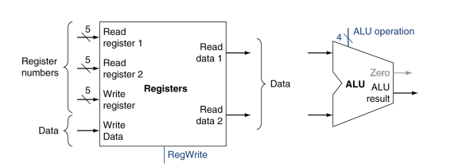
Registers file and ALU

Slide 16
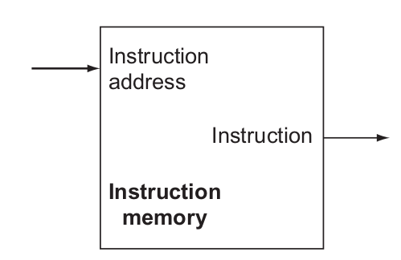
Instruction Memory
Memory
 | add $s2, $s0, $s1
500
504 | sub $s5, $s3, $s4
Instruction memory is an element that provides read access to the instructions of a program.
Given an address as input, it supplies the corresponding instruction at that address.
500
add $s2, $s0, $s1
Note: MIPS has separate instruction and data memory.
All inputs and outputs are in binary

Slide 17
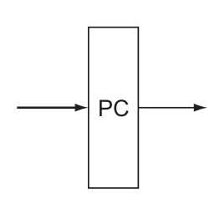
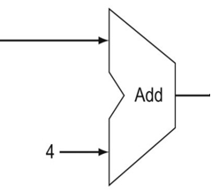
Program Counter and an Adder
The PC is an element that holds the address of the current instruction.
It is just a 32-bit register which holds the instruction address.
After reading the instruction from the memory, PC counter is incremented by 4 to point to the next instruction.
The increment by 4 as the next instruction is after 4 cells in the byte-addressable memory.
An adder is an element that adds value four to an input.

Slide 18
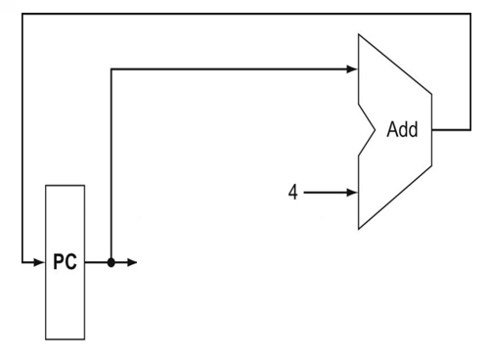

Program Counter and an Adder
Memory
500 | add $s2, $s0, $s1
504 | sub $s5, $s3, $s4
PC
500
504

Slide 19
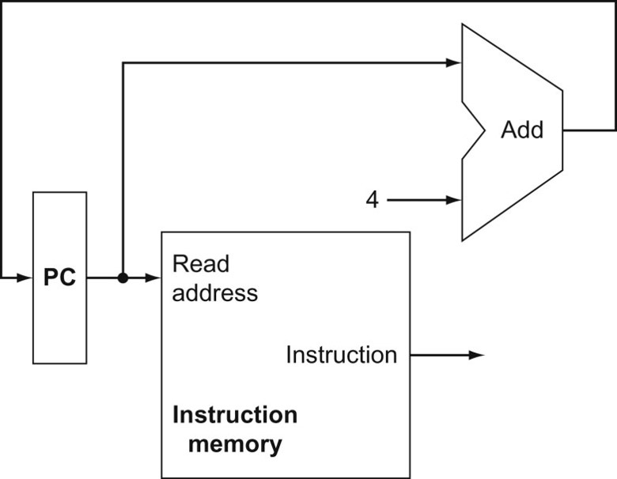
Program Counter, an Adder, and Instruction Memory
The address from the PC goes to the instruction memory, which returns the instruction.
The PC goes to an adder which adds 4 to get the next value of the PC.
Later, we will that there is a separate adder dedicated to updating the PC.

Slide 20
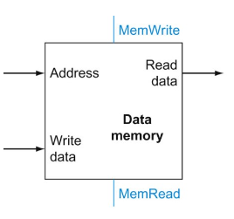
Data Memory Unit
Memory
200
204 | 50
208
Reading from address 204
204
50

Slide 21
Data Memory Unit
Memory
200
204 | 50
208
Writing 70 to address 208
208
70
70

Slide 22
Data Memory Unit
The data memory stores ALU results.
The data memory accepts a address and either accepts data through WriteData port if the instruction is writing in memory or outputs data if the instruction is reading from memory through WriteData port at the indicated address.
Note: Separate instruction and data memory.

Slide 23
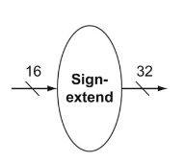
Sign Extender
The sign extender adds 16 leading digits to a 16-bit word with most significant bit b, to output the same value in a 32-bit word.
The additional 16 digits have the same value as b.
0000000000000000
0000000000011010
1111111111111111
1111111111101100

Slide 24
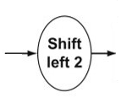
Shift left 2
The “Shift left 2” element, performs a multiplication by 4 to the input value.

Slide 25
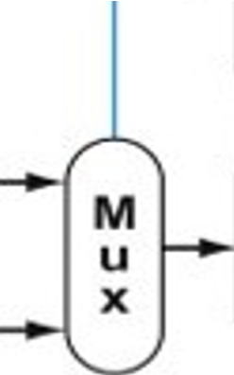
2x1 Multiplexers
In the Datapath, we will need 2x1 multiplexers
Each 2x1 multiplexer has one selection line.
0
1

Slide 26
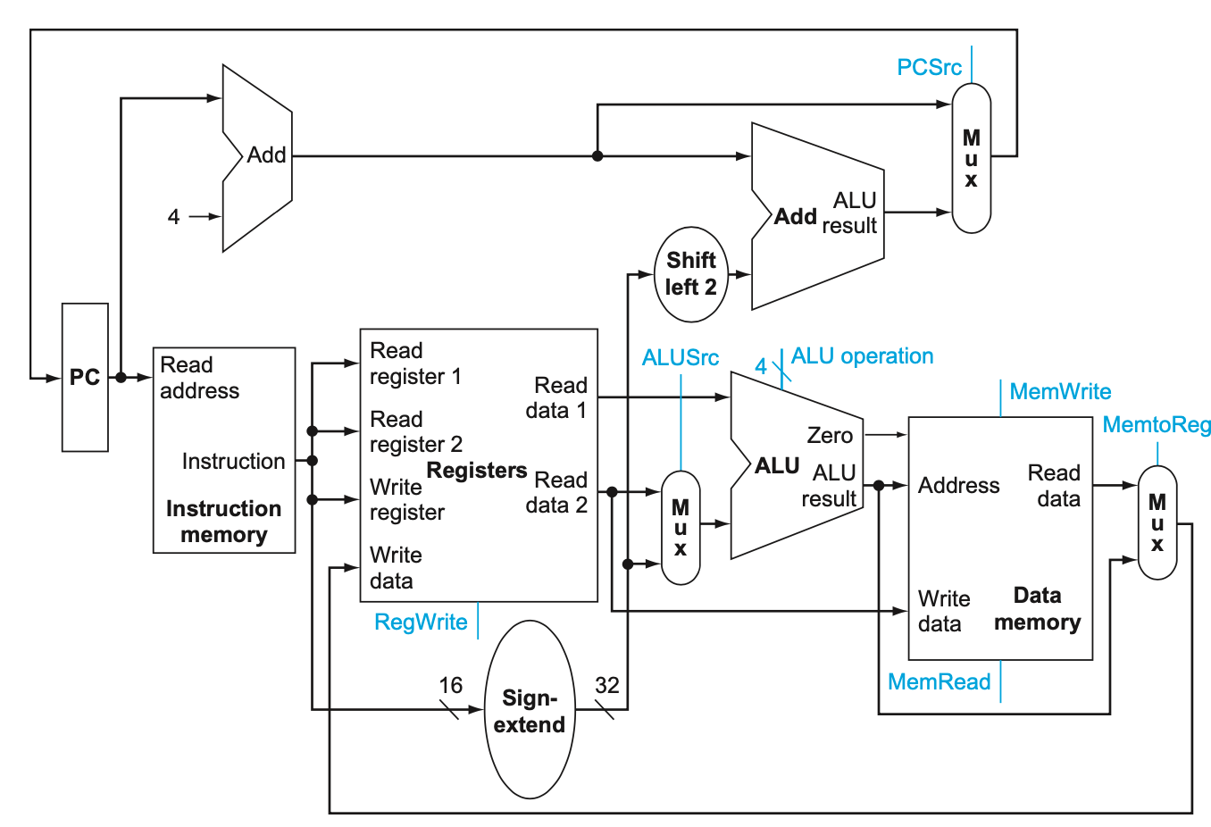









Scenario for R-format instructions
add $s2, $s0, $s1
0 | 16 | 17 | 18 | 0 | 32

Slide 27









Scenario for I-format instructions
addi $s1, $s0, 20
8 | 16 | 17 | 20

Slide 28












Scenario for I-format instructions
lw $s0, 5($t1)
35 | 10 | 16 | 5

Slide 29




Scenario for I-format instructions
sw $s1, 8($t1)
43 | 10 | 17 | 8

Slide 30
So why do we need MUXs?
The datapath is dealing with different formats and various options

Slide 31
Datapath with some control lines

Slide 32
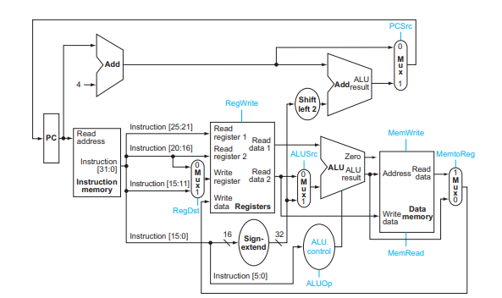



Datapath with some control lines

Slide 33
R-format instructions
add $s2, $s0, $s1
0 | 16 | 17 | 18 | 0 | 32
bits 31 –26 | bits 25--21 | bits 20-16 | bits 15--11 | bits 10--6 | bits 5—0
opcode | Reading Register number | Reading register number | Writing register number | shamt | funct

Slide 34










Scenario for R-format instructions

Slide 35
Control Signal Table
instruction | RegDst | RegWrite | ALUSrc | MemWrite | MemRead | MemToReg | PCSrc
add | 1 | 1 | 0 | 0 | 0 | 0 | 0
sub | 1 | 1 | 0 | 0 | 0 | 0 | 0
and | 1 | 1 | 0 | 0 | 0 | 0 | 0
or | 1 | 1 | 0 | 0 | 0 | 0 | 0

Slide 36
I-format instructions
addi $s1, $s0, 20
0 | 16 | 17 | 20
bits 31 –26 | bits 25--21 | bits 20-16 | bits 15--0
opcode | Reading Register number | Writing register number | immediate

Slide 37




Scenario for addi instruction

Slide 38
Control Signal Table
instruction | RegDst | RegWrite | ALUSrc | MemWrite | MemRead | MemToReg | PCSrc
add | 1 | 1 | 0 | 0 | 0 | 0 | 0
sub | 1 | 1 | 0 | 0 | 0 | 0 | 0
and | 1 | 1 | 0 | 0 | 0 | 0 | 0
or | 1 | 1 | 0 | 0 | 0 | 0 | 0
addi | 0 | 1 | 1 | 0 | 0 | 0 | 0

Slide 39
I-format instructions
lw $s0, 5($t1)
35 | 10 | 16 | 5
bits 31 –26 | bits 25--21 | bits 20-16 | bits 15--0
opcode | Reading Register number | Writing register number | offset

Slide 40





Scenario for lw instruction

Slide 41
Control Signal Table
instruction | RegDst | RegWrite | ALUSrc | MemWrite | MemRead | MemToReg | PCSrc
add | 1 | 1 | 0 | 0 | 0 | 0 | 0
sub | 1 | 1 | 0 | 0 | 0 | 0 | 0
and | 1 | 1 | 0 | 0 | 0 | 0 | 0
or | 1 | 1 | 0 | 0 | 0 | 0 | 0
addi | 0 | 1 | 1 | 0 | 0 | 0 | 0
lw | 0 | 1 | 1 | 0 | 1 | 1 | 0

Slide 42
I-format instructions
sw $s1, 8($t1)
43 | 10 | 17 | 8
bits 31 –26 | bits 25--21 | bits 20-16 | bits 15--0
opcode | Reading Register number | Reading register number | offset

Slide 43



Scenario for sw instruction

Slide 44
Control Signal Table
instruction | RegDst | RegWrite | ALUSrc | MemWrite | MemRead | MemToReg | PCSrc
add | 1 | 1 | 0 | 0 | 0 | 0 | 0
sub | 1 | 1 | 0 | 0 | 0 | 0 | 0
and | 1 | 1 | 0 | 0 | 0 | 0 | 0
or | 1 | 1 | 0 | 0 | 0 | 0 | 0
addi | 0 | 1 | 1 | 0 | 0 | 0 | 0
lw | 0 | 1 | 1 | 0 | 1 | 1 | 0
sw | x | 0 | 1 | 1 | 0 | x | 0

Slide 45
BEQ instruction
li $s1, 5
li $s2, 3
beq $s1, $s2, label
add $t0, $t1, $t2
mul $t3, $t1, $t2
div $t3, $t1, $t2
label: sub $t0, $t1, $t2
beq $s1, $s2, label
3 instructions to the place of branch
5 | 17 | 18 | 3
How to get the real address:
(PC+4) + (offset*4)
I-format
opcode | rs | rt | offset
6 bits | 5 bits | 5 bits | 16 bits
32 bits

Slide 46
I-format instructions
beq $s1, $s2, 3
5 | 17 | 18 | 3
bits 31 –26 | bits 25--21 | bits 20-16 | bits 15--0
opcode | Reading Register number | Reading register number | offset
How to get the real address:
(PC+4) + (offset*4)

Slide 47
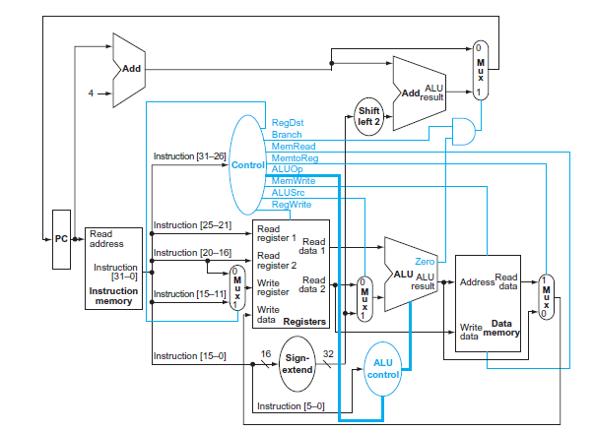
















Scenario for beq instruction
The red way if branch is not taken
The green way if branch is taken

Slide 48

Control Signal Table
instruction | RegDst | RegWrite | ALUSrc | MemWrite | MemRead | MemToReg | PCSrc
add | 1 | 1 | 0 | 0 | 0 | 0 | 0
sub | 1 | 1 | 0 | 0 | 0 | 0 | 0
and | 1 | 1 | 0 | 0 | 0 | 0 | 0
or | 1 | 1 | 0 | 0 | 0 | 0 | 0
addi | 0 | 1 | 1 | 0 | 0 | 0 | 0
lw | 0 | 1 | 1 | 0 | 1 | 1 | 0
sw | x | 0 | 1 | 1 | 0 | x | 0
beq | x | 0 | 0 | 0 | 0 | x | 1
RegDst = 0 is also correct
PCSrc = 1 if Branch =1
PCSr =0 if Branch =0

Slide 49
Problem 1
In order to correctly execute the beq instruction, the control signals Zero and Branch were added to the design of the datapath.
Explain why neither of those control signals would be sufficient by itself.
Solution:
- The Zero signal indicates whether the result computed by the ALU equals zero; that has nothing to do with affecting the Program Counter.
- The Branch signal indicates whether the current instruction is beq, but nothing about whether the two registers are equal.
- The branch to the target instruction if the current is beq AND the two registers involved are equal. So, we need both signals.

Slide 50
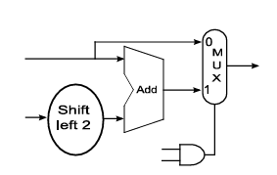
Problem 2
The hardware shown was inserted when the datapath was extended for a specific instruction. Identify the instruction and explain what is the need for this extension.
Solution:
This hardware is used to compute the branch target address and determine which address to pass back to the PC.
If the branch signal is 1, the PC will have the address of the target instruction by the beq instruction.
If the branch signal is 0, the Pc will have the value PC+4 referring to the next instruction and indicating that the branch will not be taken.

Slide 51
Problem 3
What is gained by applying sign extension to bits from addi instruction?
Solution:
- The add immediate adds a value from a register of 32 bits to the an immediate value, the immediate value is 16-bits from the instruction.
Thus, the immediate value should be extended to 32 bits so the ALU could operate on two 32-bits operands

Slide 52
Problem 4
What is gained by applying Shift left 2 to bits from beq instruction?
Solution:
- Because beq instruction is in I-format and the least significant 16 bits represents the number of instructions between the beq and the target instruction.
- As each instruction takes 4 cells in memory, the number of instructions is first multiplied by 4 using shift left 2 before adding it to PC+4 to get the address of the branch target instruction.

Slide 53

Thank You

